Slide 1
Kaggle Competition: Santander Customer Transaction Prediction
Presented by: Dan MacGirr
Ryerson ID: 500302488

Slide 2
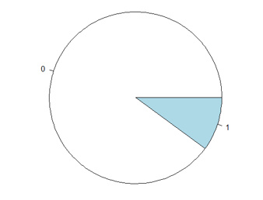
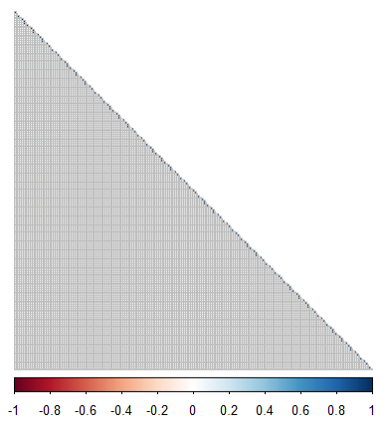
Exploratory Data Analysis
200,000 observations - All data has been completely anonymized
Target Variable
Independent Variables
Binary - Unbalanced
10% positive
90% negative
200 Independent Variables
All numeric
All (mostly) normally distributed
All variable names have been masked
No NA values, no correlation

Slide 3
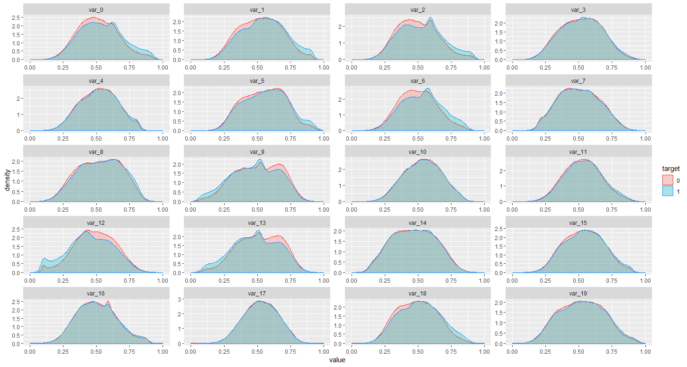
Exploratory Data Analysis
Mostly normal. Slightly lumpy
Some of the variables have a sharp hump
Other variables seem to have multiple peaks
Could this be indicative of multiple populations being combined into one?

Slide 4
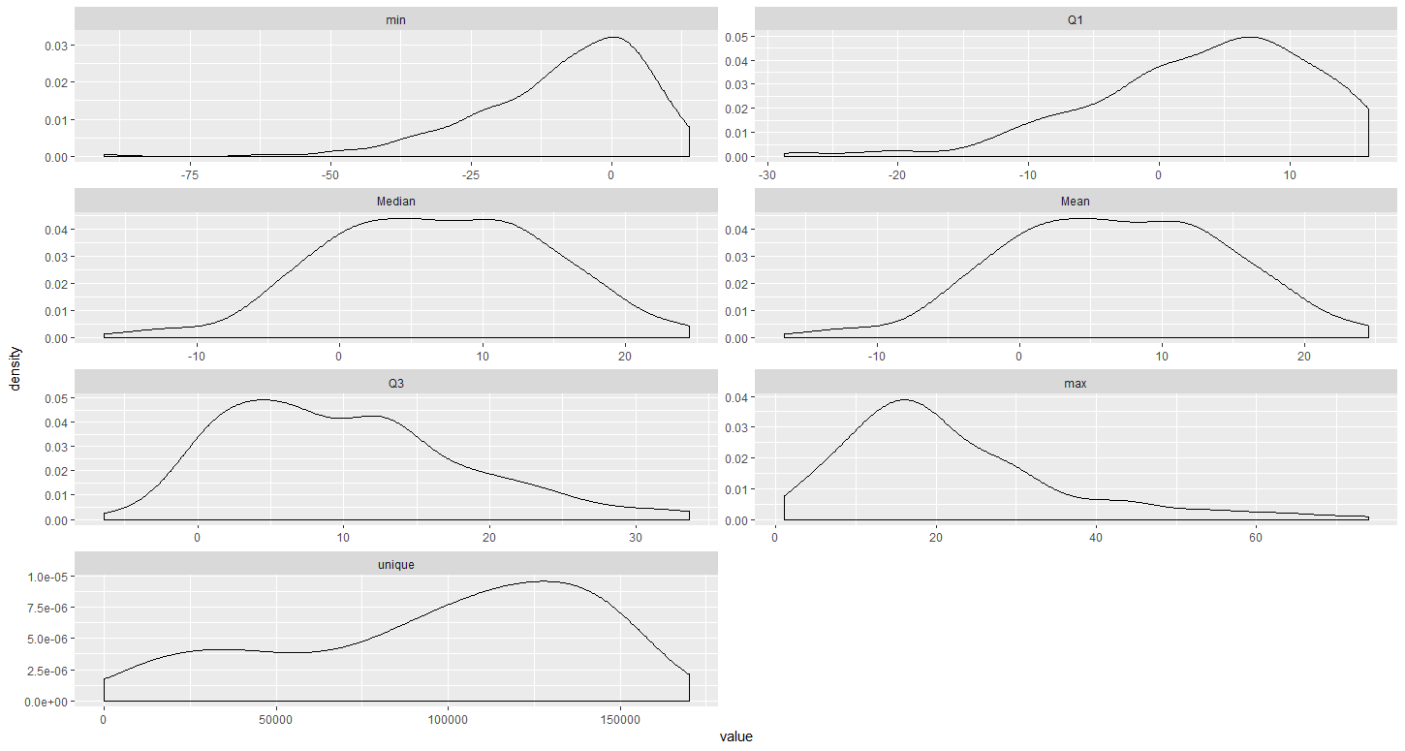
Exploratory Data Analysis
Mostly normal. Slightly lumpy
The summary function from the Hmisc package will produce the following density plots once put into data frame format
Could this be indicative of multiple populations being combined into one?

Slide 5
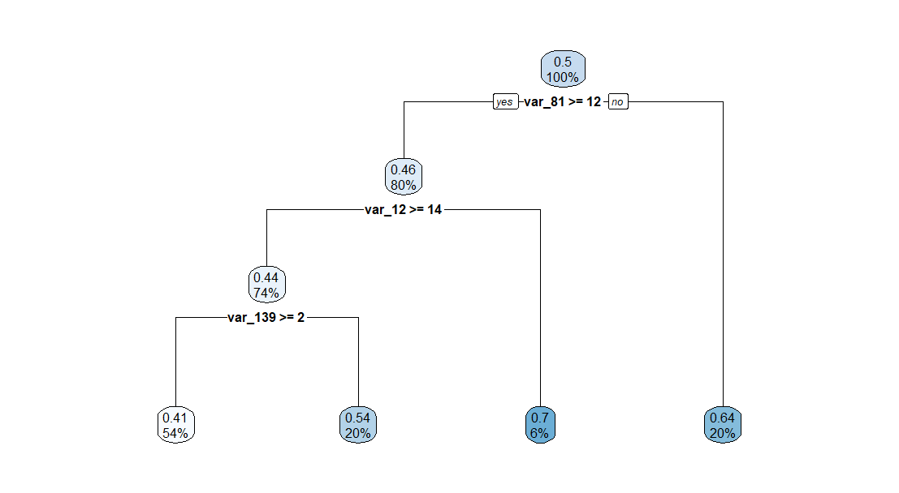
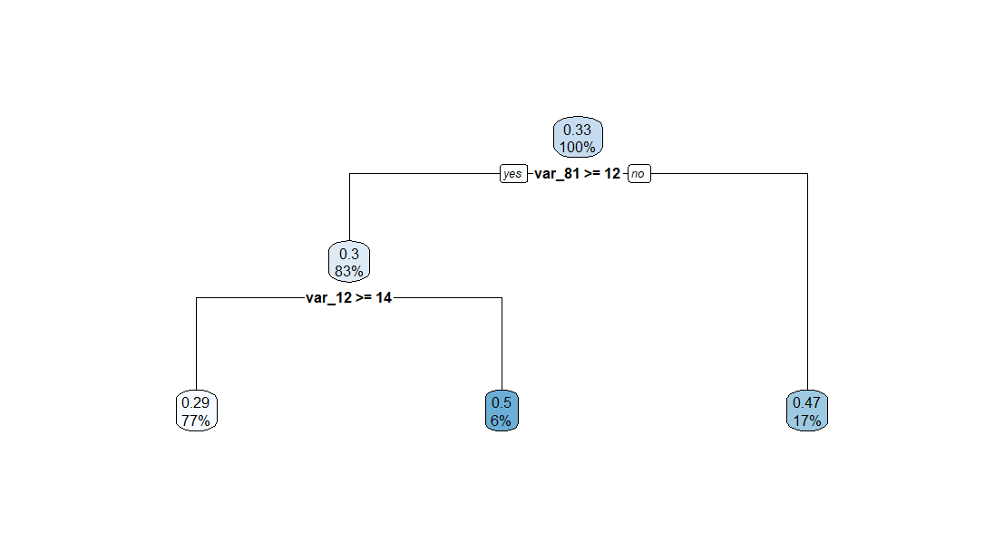
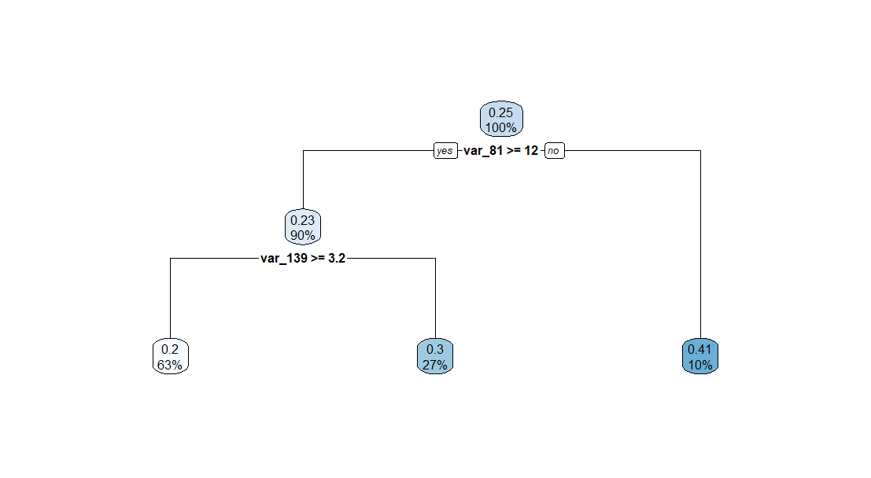
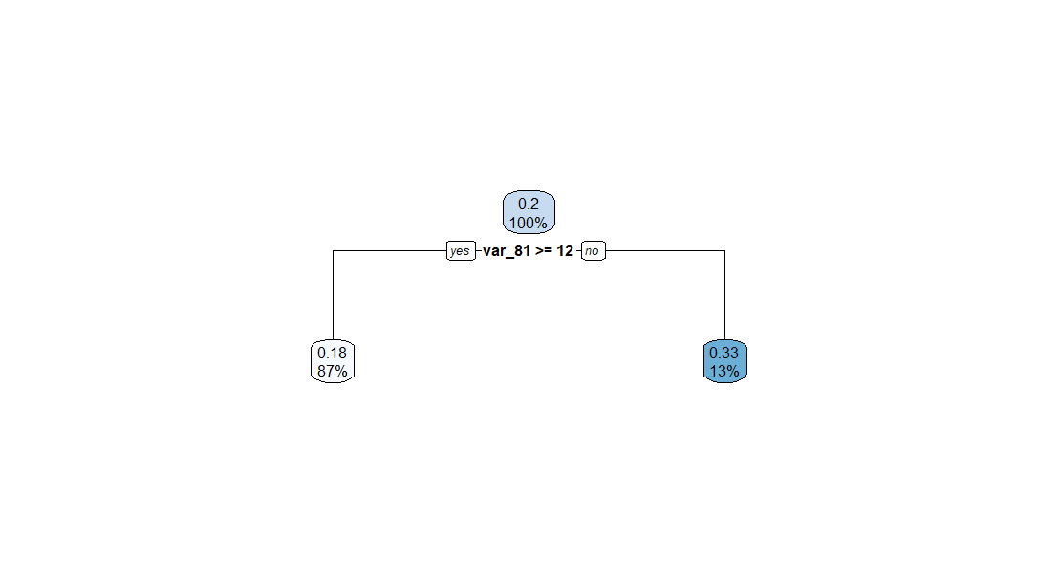
Balancing the sample
All things are not created equal
The training set is clearly very unbalanced. What happens when we balance things out a bit?
tree1
tree2
tree3
tree4
Target = 1 : 10,000
Target = 0 : 10,000
Target = 1 : 10,000
Target = 0 : 20,000
Target = 1 : 10,000
Target = 0 : 30,000
Target = 1 : 10,000
Target = 0 : 40,000
Var_81 >= 12
Var_12 >= 14
Var_139 >= 2
Var_81 >= 12
Var_12 >= 14
Var_81 >= 12
Var_139 >= 3.2
Var_81 >= 12

Slide 6
Identifying Key Variables
200 variables? That’s a lot!
Identifying Unnecessary Variables
Benefit of removing unnecessary variables
The following variables were not include in stepAIC:
No change to Kaggle score. Slight improvement in run time
Var_07
Var_10
Var_17
Var_27
Var_30
Var_38
Var_41
Var_96
Var_100
Var_103
Var_117
Var_126
Var_185
Glm trained on all variables:
Kaggle score: 0.86
Time to complete: ~4 hours
Glm trained on sample the excludes unnecessary variables:
Kaggle score: 0.86
Time to complete: ~4 hours

Slide 7
Developing the Model
All things are not created equal
Models
Methods
Decision Tree
Linear Model (glm)
Balanced Sample
Variable Reduction
Nice visuals
Poor predictive performance
Poor visuals
Strong predictive performance
Allowed for much stronger recognition of target=1 on decision tree
Moderate gains in speed and accuracy made by made by using only top 75 variables
Random Forest
Naïve Bayes
Normalization
EDA
Prohibitively Slow
Fast performance
Moderate predictive performance
No impact on predictive performance (NB)
Var_68 – only 428 unique values?
“Lumpy” data is hiding something

Slide 8
XG Boost
Extreme Gradient Boosting: A One Stop Shop?
XGBoost has quickly become a favorite within the Kaggle community, and with good reason
Flexibility
Tuning
Accuracy
Speed
Supports both linear and tree based models.
Eight built in learning tasks / objective functions, with ability to support additional user-defined functions
Eight evaluation metrics, with ability to support additional user-defined functions
Parameters allow user to easily tune hyper-parameters to find optimal performance
Separation of cross-validation and training functions allows parameter adjustments to
Model employs three kinds of boosting
Gradient Boosting (GB)
Stochastic GB
Regularized GB
This allows it to use many iterations of simpler models
Portable and Distributed
Can engage multiple cores on a single machine, or be configured to work across multiple servers in a cluster
This allows it to run much more quickly than other algorithms of similar complexity

Slide 9
Conclusion
I’m not in Kansas any more
XG Boost Kaggle score: 0.899
Highest score that I was able to achieve with other algorithms:
Glm: 0.86
Naïve Bayes: 0.779
Decision Tree: 0.605
Random Forest: TBD – Still running
XG Boost leverages recent technological advances to make it feasible to analyze large datasets using advanced methods while also giving users the ability to finely tune the analysis, thereby increasing accuracy.

